Slide 1







Trend Brief Workshop:
AI in tourism mobility:
Trends and Insights
Eva Hollauf, MA
(Salzburg Research)

Slide 2

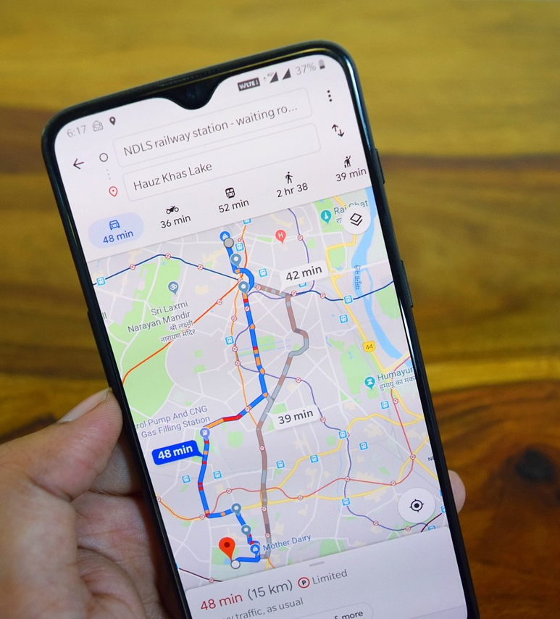
What has changed?

Slide 3
Where does Machine Learning have Impact?

Slide 4

Why Deep Learning?
AI
Machine Learning
Deep Learning
AI
Deep learning
Improved efficiency
Cost reduction
Enhanced decision-making
Personalized customer experiences
Analyze large volumes of data quickly
Performance
Older learning algorithms
Amount of data

Slide 5
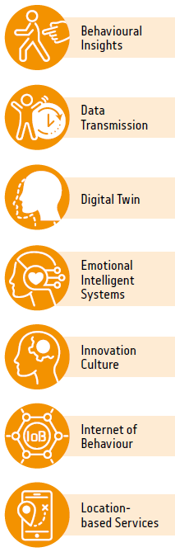
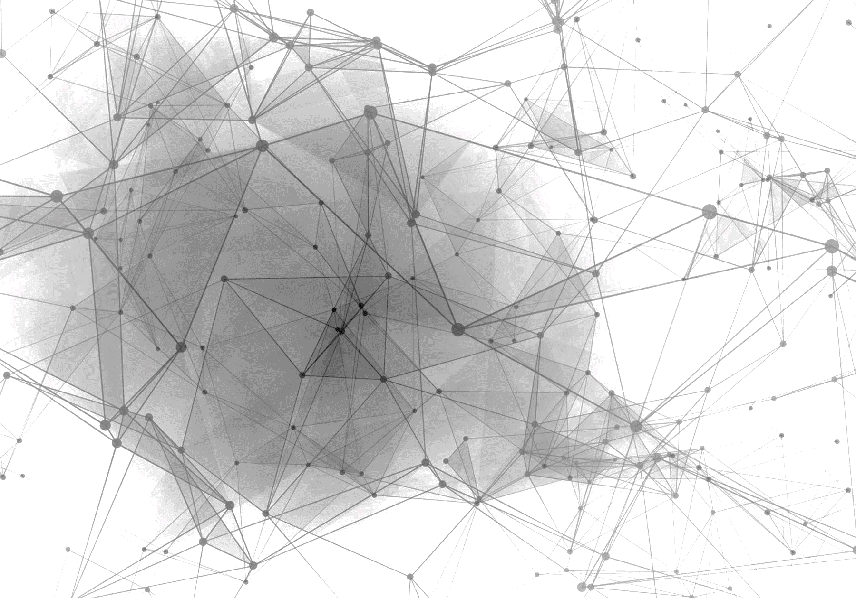
What is trending?
Transparency &
Privacy
WATCH
Critical
Enablers
Transparency &
Privacy
WATCH
Critical
Enablers
PREPARE
Neuromorphic
computing
Responsible AI
PREPARE
Neuromorphic
computing
Human-Centered AI
ACT
ACT
Edge Computer Vision
Model
Compression
Edge Computer Vision
Model
Compression
Smart Space
Edge AI
Smart Space
Edge AI
Self-Supervised
Learning
Self-Supervised
Learning
Synthetic Data
Synthetic Data
Spatial Computing
Spatial Computing
Generative AI
Smart
World
Generative AI
Productivity
Revolution
Smart
World
Productivity
Revolution

Slide 6
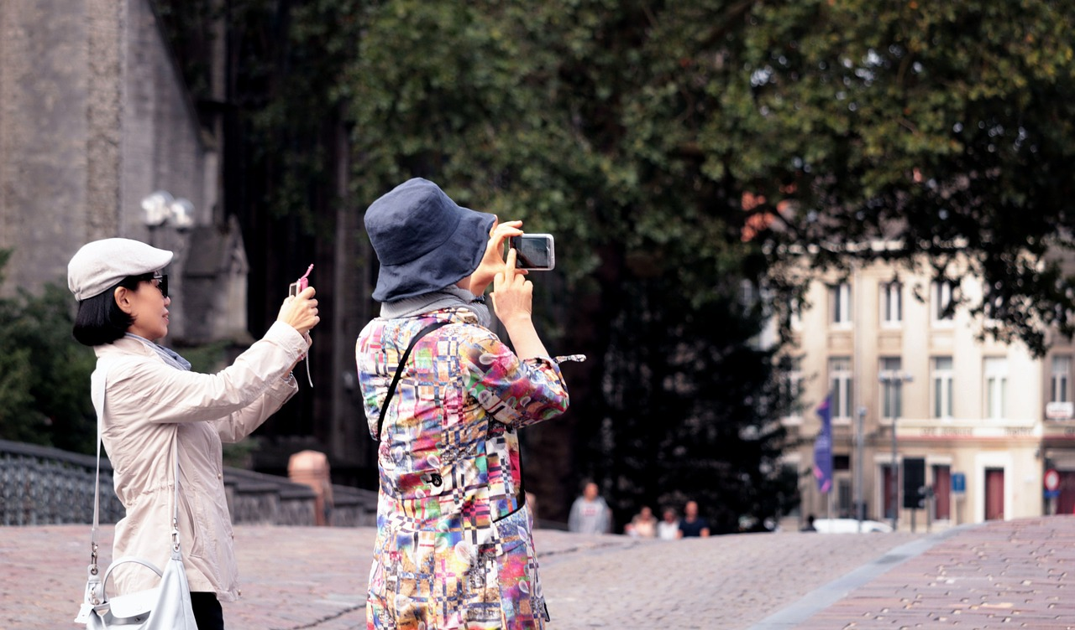
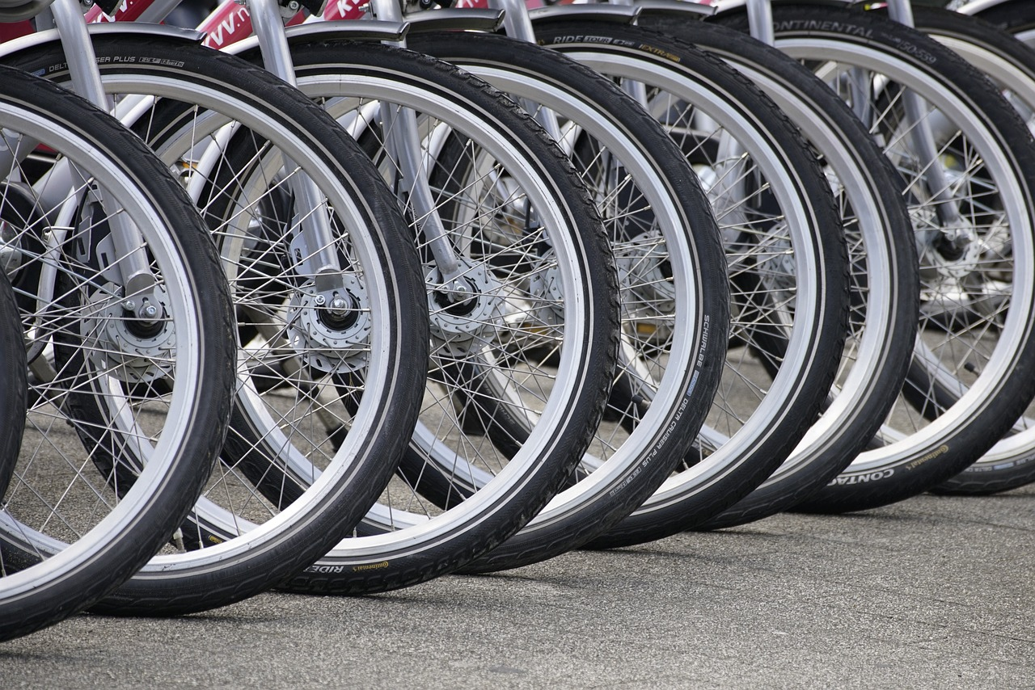
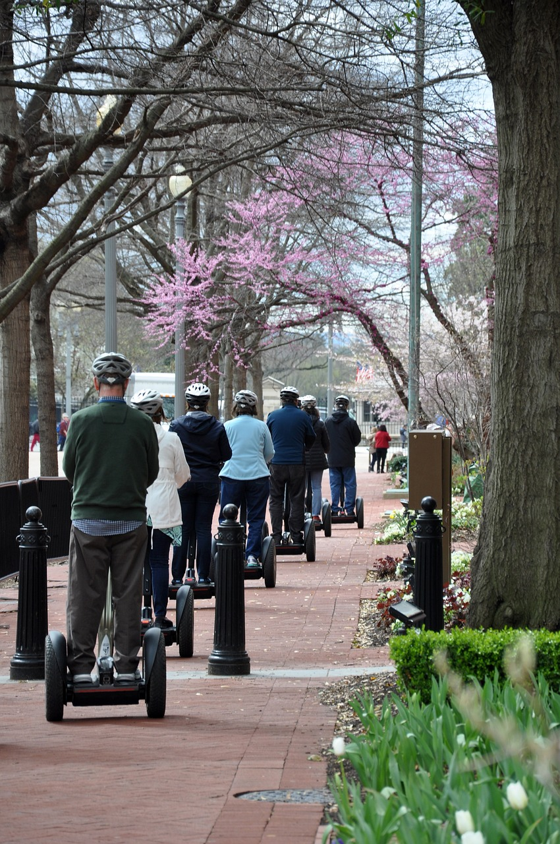
Future of AI in Tourism Mobility
Autonomous Transportation
Smart mobility solutions
Dynamic crowd management
Location-based services
Sustainable tourism practices
AI will drive the development of autonomous vehicles, including self-driving taxis, buses, and shuttles, in tourist destinations.
Smart mobility platforms integrate various mobility modes, allowing tourists to plan and book multi-modal journeys (flights, taxis, etc.)
Optimize tourist flow at popular attractions and events, reducing congestion and enhancing visitor experiences.
Offer tourists real-time information, recommendations, and discounts based on their location and preferences.
Optimizing travel routes and encouraging eco-friendly transportation options

Slide 7

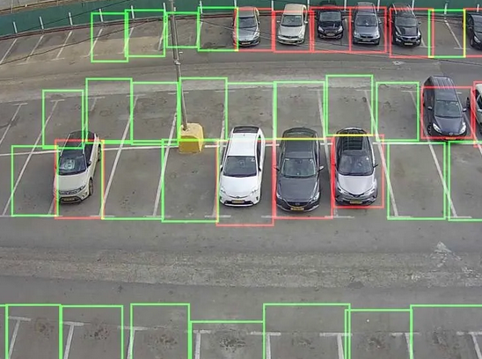
Technology Readiness
Use cases in your industry
Low
Med
High
AI-Assisted Parking Lot Occupancy
Market Readiness
Low
Med
High
Using deep learning algorithms, a Swiss start-up can compute objects in a camera video stream. This can be used to smart. It helps reduce traffic congestion in peak hours.
AI affects the…
Process
Product
Communication
VisoAI, n.d.

Slide 8
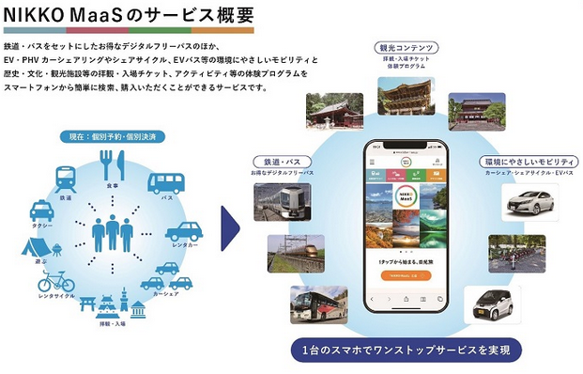
Technology Readiness
Use cases in your industry
Low
Med
High
Market Readiness
Low
Med
High
AI affects the…
Process
Product
Communication
Nikko MaaS, 2021

Slide 9
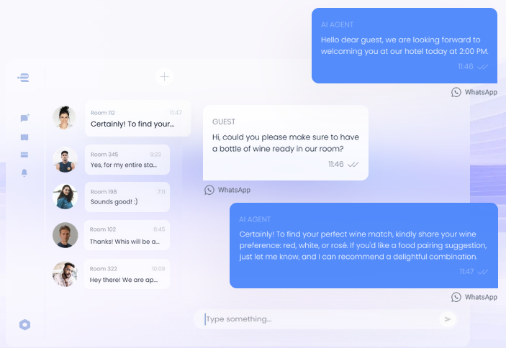
Technology Readiness
Use cases in your industry
Low
Med
High
Generative AI hotel concierge
Market Readiness
Low
Med
High
AI affects the…
Process
Product
Communication
EasyWayAI, n.d.

Slide 10
Technology Readiness
Use cases in your industry
Low
Med
High
Market Readiness
Low
Med
High
https://www.pyxisai.com/
AI affects the…
Process
Product
Communication

Slide 11


To select the best AI tools, businesses should:
Verify long-term viability
Calculate potential ROI
Assess data privacy & integration
Consider maintenance of the system
Evaluate expertise
Research options
Ensure scalability and integration
Test during a trial period
Analyze costs
Check user feedback
Define specific needs

Slide 12

Tips for integrating AI at your workplace
1
UNDERSTAND YOUR GOALS
How can AI deal with your pain factors?
2
ENSURE DATA QUALITY
The highest data quality delivers the greatest insight
3
DISCUSS WITH YOUR TEAM
Instruct/discuss its potential benefits with your team
4
ASSIST HUMAN SKILLS
See how AI can complement, not replace, worker tasks
5
START SMALL WITH PILOTS
Initially, explore AI solutions in a managed environment
6
ITERATE AND LEARN
Continuously improve its implementation
7
CHOOSE THE RIGHT AI
Choose AI tools align with your goals
8
CHANGE MANAGEMENT STRATEGIES
Based on new AI capabilities

Slide 13

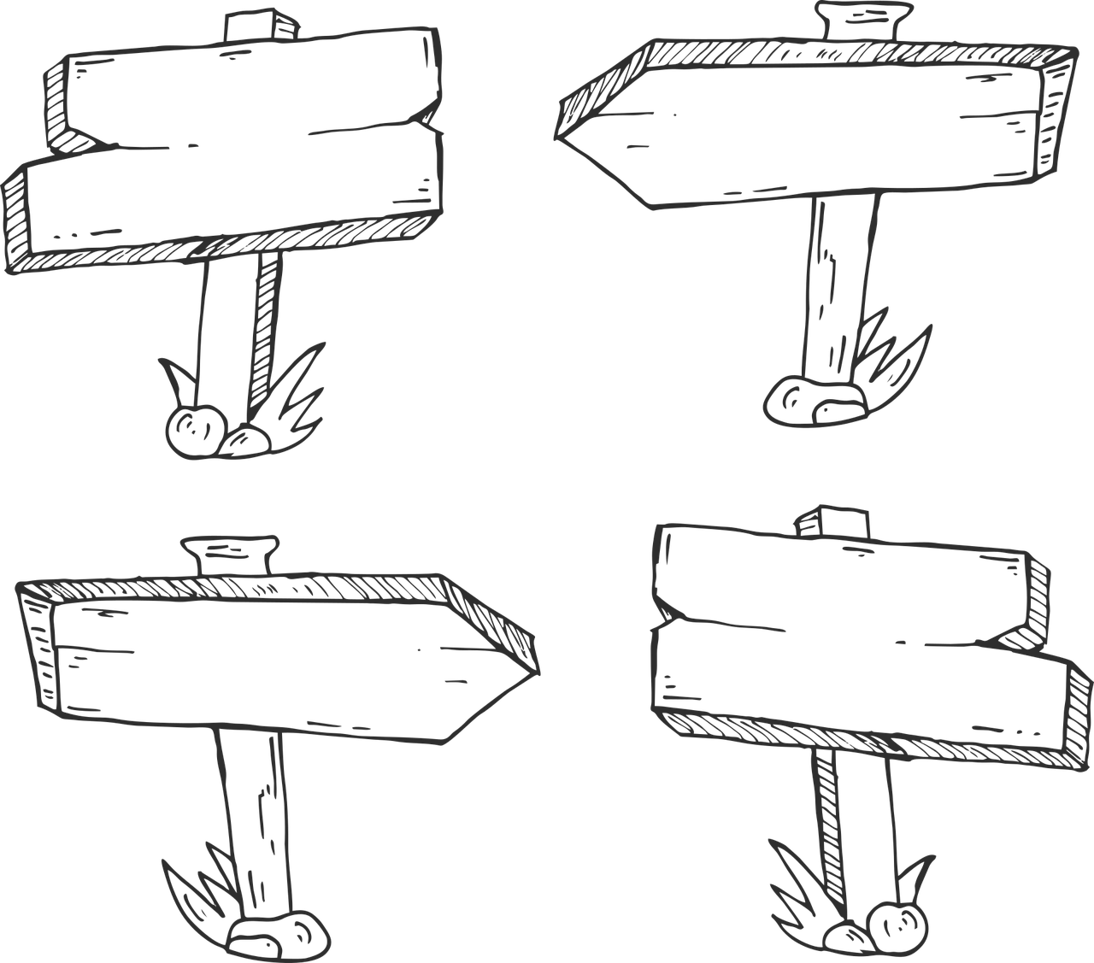


Where to go from here?
If you would like to:
Realize your innovation potentials
Grasp empowering AI tools for your business processes
Make the most out of your company‘s data
Better recognize your customers‘ needs
Search out potential new business models in times of the digital transformation
Let‘s unpack it together

Slide 14

(P.S. - Some of this presentation‘s contents were made using generative AI!)
Thank you!
Eva Hollauf, MA
(Salzburg Research)
+43/662/2288-319
eva.hollauf@salzburgresearch.at

