Slide 1
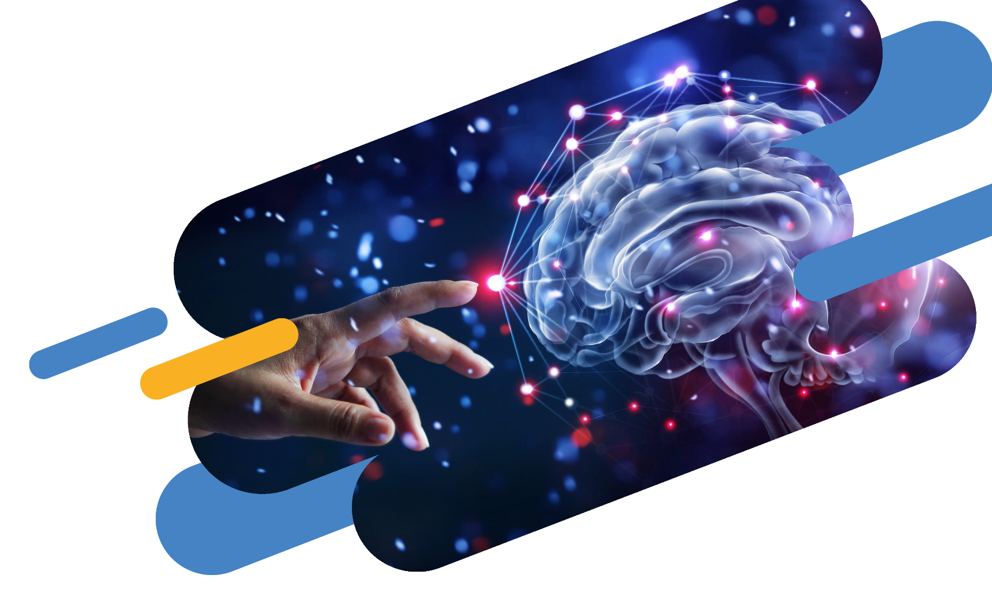

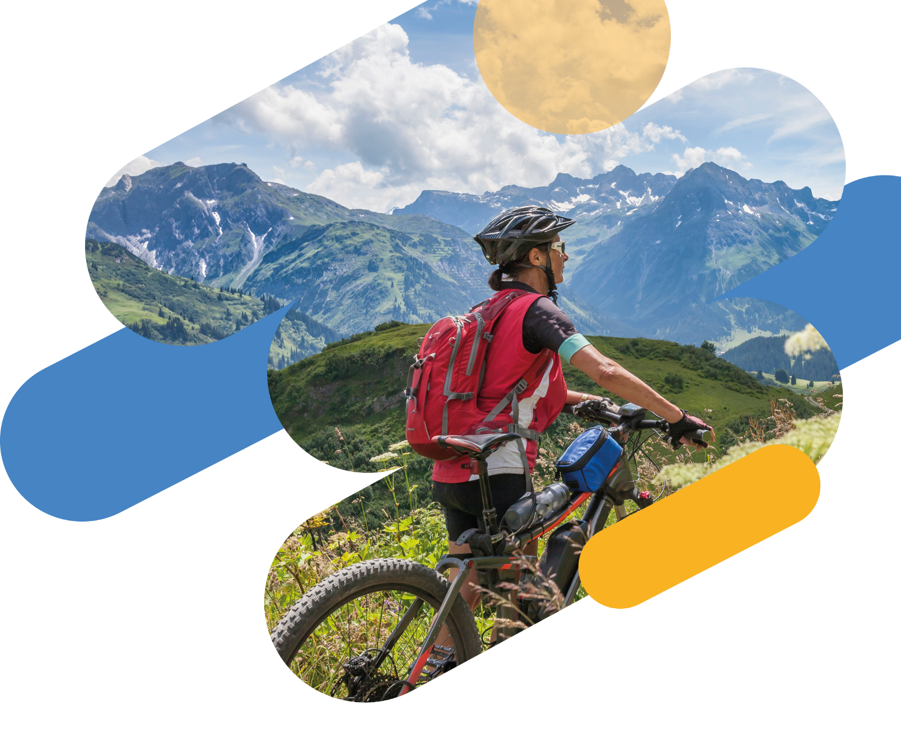

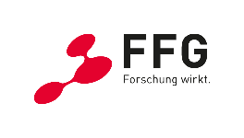


Trend Brief:
Future Trends on AI
to support Health and Well-being

Slide 2



About today
11.00 | Welcome and event objectives Eva Hollauf, Salzburg Research, Coordinator EDIH Crowd in Motion
11.05 | Trend brief: AI’s advancement to promote health and well-being Michael Thelen, Salzburg Research / EDIH Crowd in Motion
11.15 | Use cases and project insights in AI for health and prevention Saskia Kaltenbrunner, Universität Wien
11.30 | Swedish experiences in promoting AI in health and prevention: Health Data Sweden and Sports Technology Sebastiaan Meijer & Jonas Willen, KTH Royal Institute of Technology, Center for Sports Engineering / EDIH Health Data Sweden
11.45 | „Relax“: a learning agent for individualized stress management Oliver Jung, Salzburg Research / EDIH Crowd in Motion
12.00 | Q&A and Closing
12.15 | End of trend break – Enjoy your lunch!
Notes:
Organisation (mute, questions chat --> Q&A at the end, recording, we will contact you afterwards with a summary and information about EDIH and services), visit Crowd in Motion Website

Slide 3
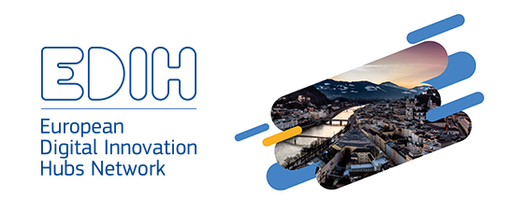
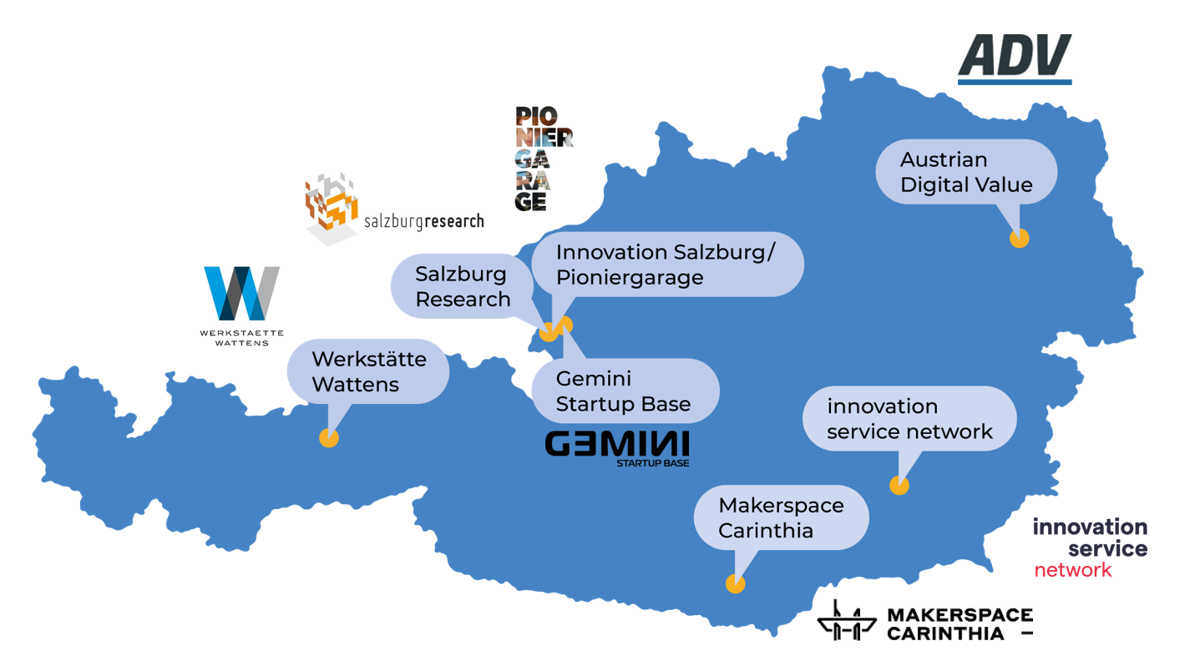
Innovation support for the digital transformation in the tourism, sport and leisure industry
www.crowd-in-motion.eu

Slide 4
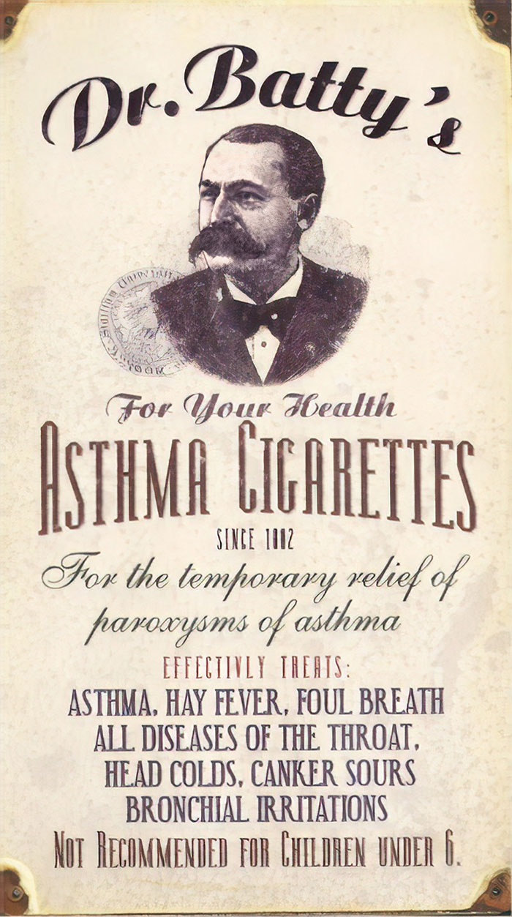
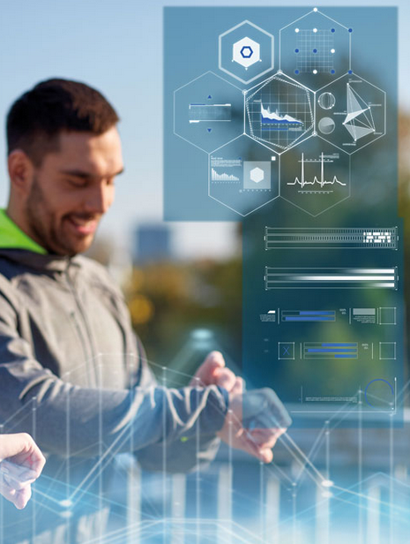
What has changed?

Slide 5
Where does Machine Learning have Impact?

Slide 6
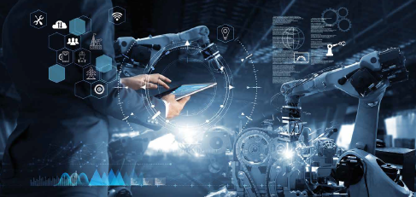
Why Deep Learning?
AI
Machine Learning
Deep Learning
AI
Deep learning
Improved efficiency
Cost reduction
Enhanced decision-making
Personalized customer experiences
Analyze large volumes of data quickly
Performance
Older learning algorithms
Amount of data

Slide 7
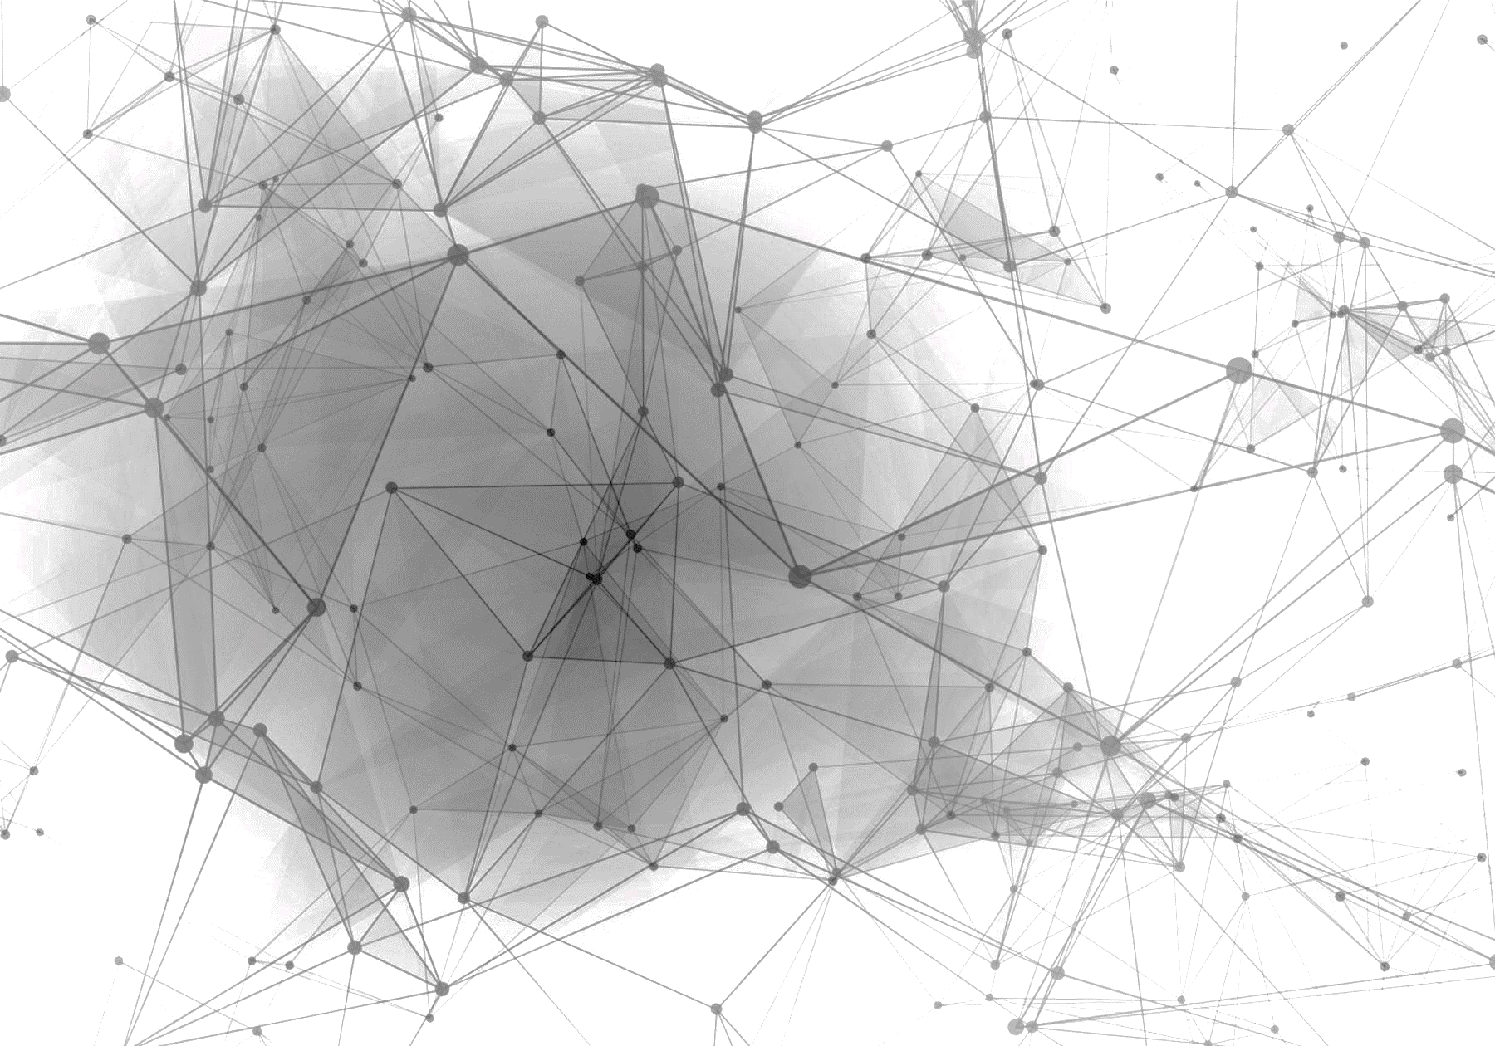
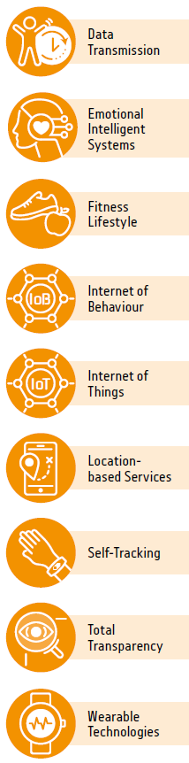
What is trending?
Transparency &
Privacy
WATCH
Critical
Enablers
PREPARE
Responsible AI
ACT
Neuromorphic
computing
Human-Centered AI
Edge Computer Vision
Model
Compression
Smart Space
Edge AI
Now to 3 Years
Self-Supervised
Learning
Synthetic Data
Spatial Computing
1 to 3 Years
3 to 6 Years
Generative AI
Smart
World
Productivity
Revolution
6 to 8 Years
Range until mainstream adoption

Slide 8
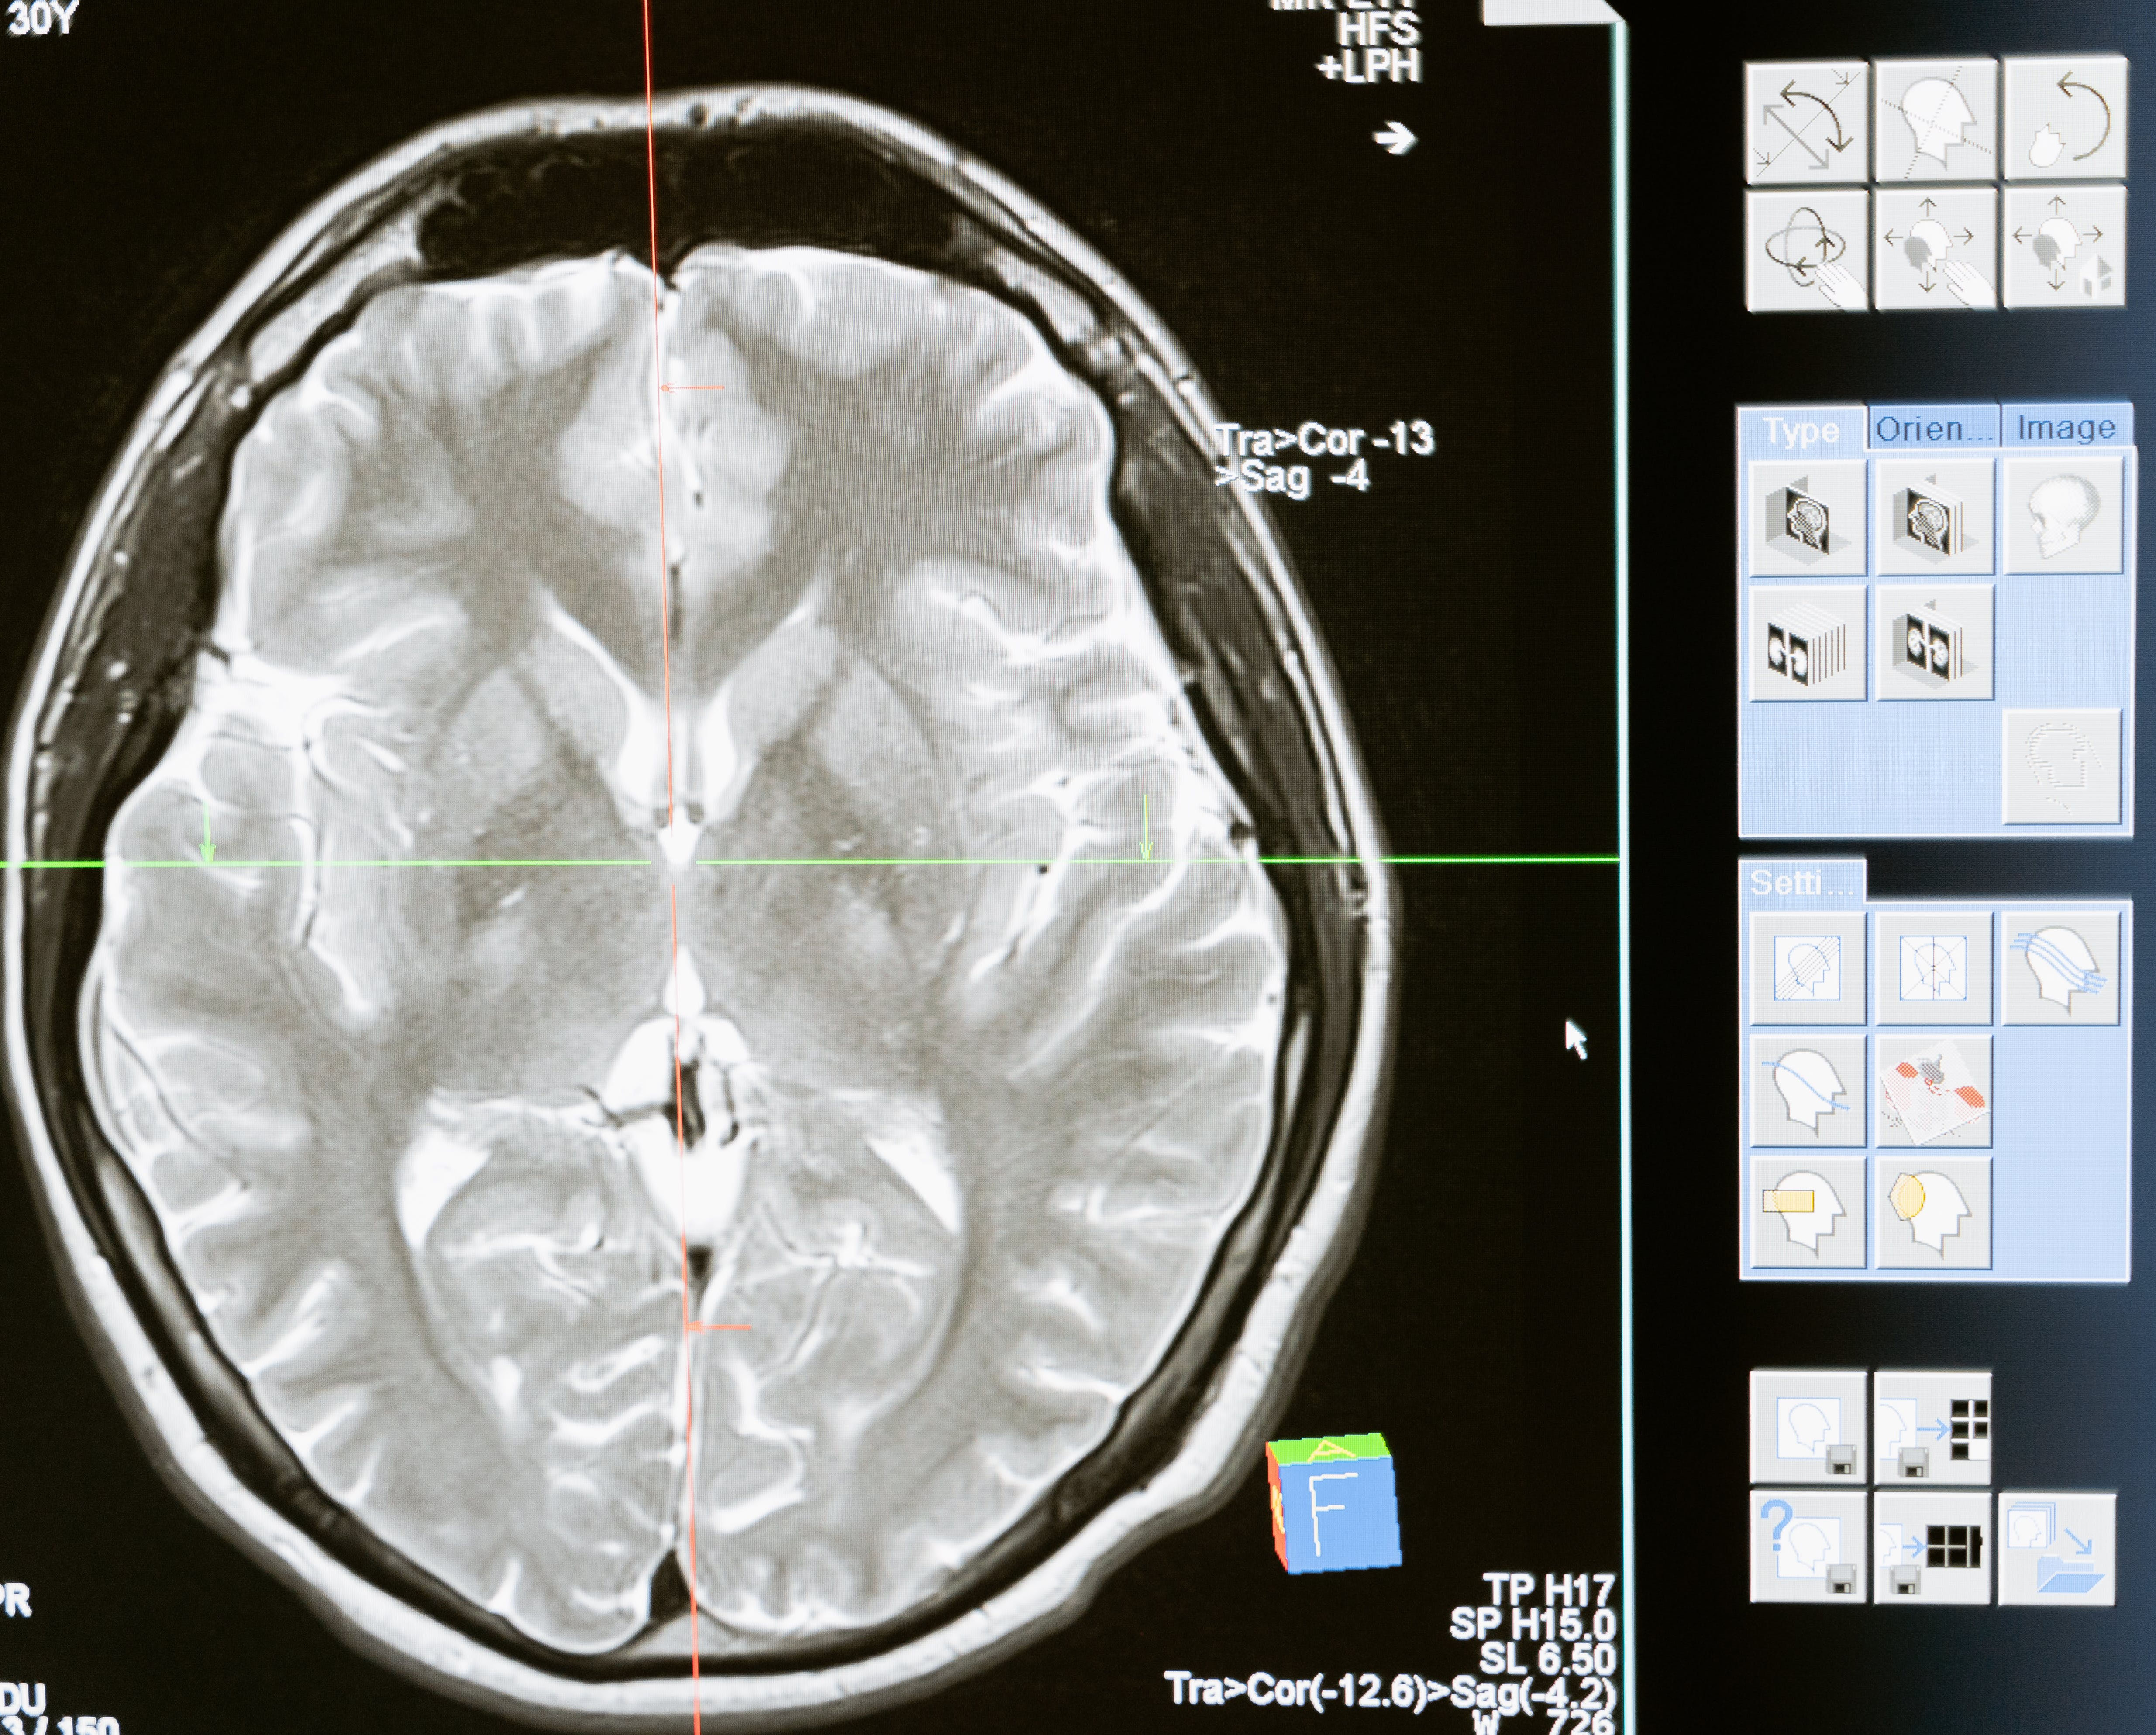
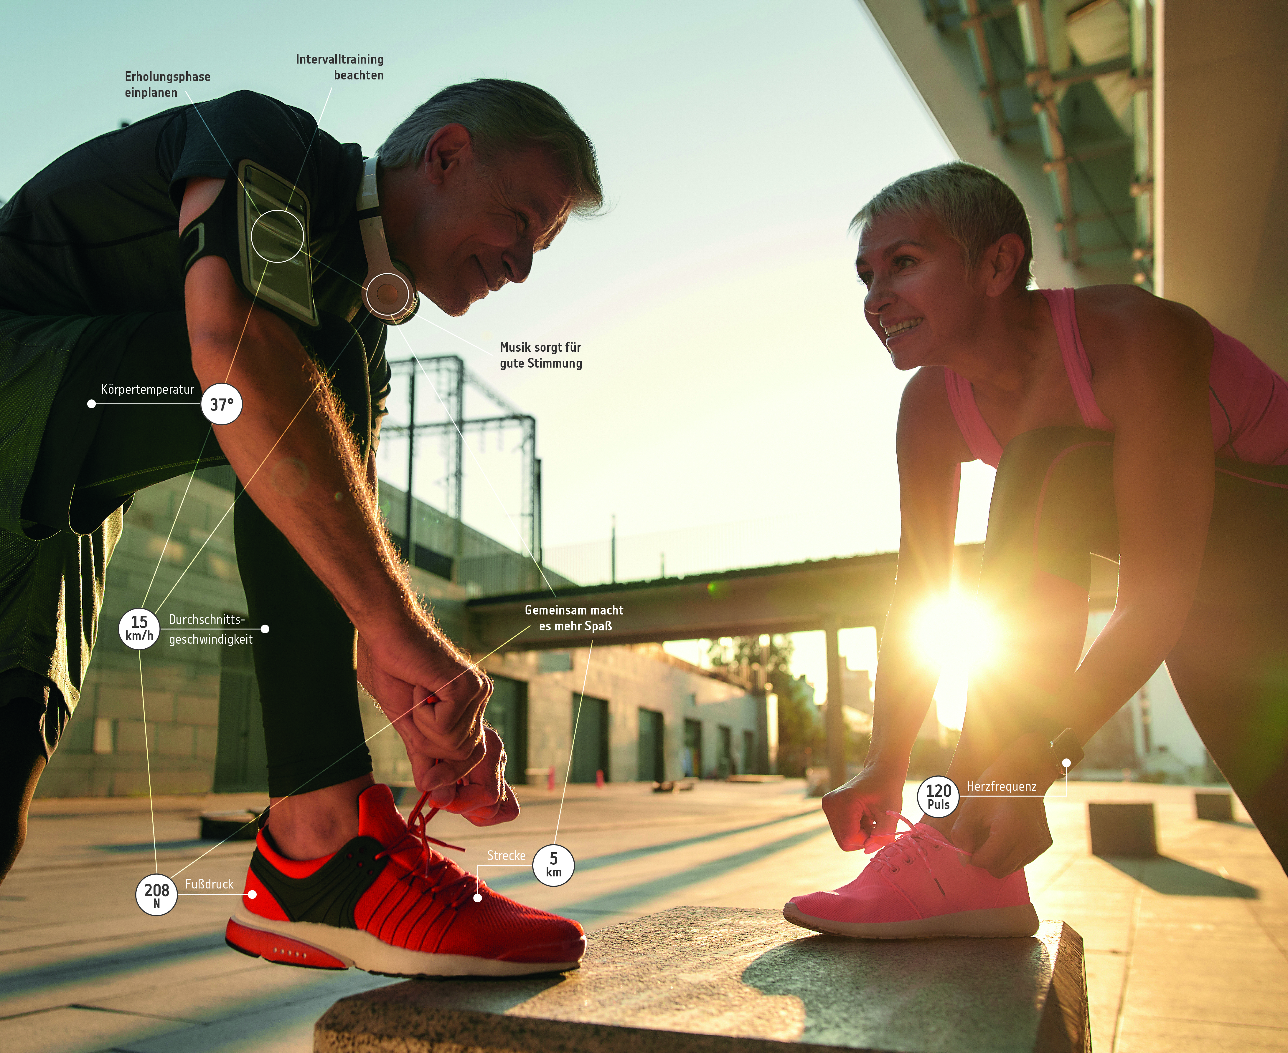
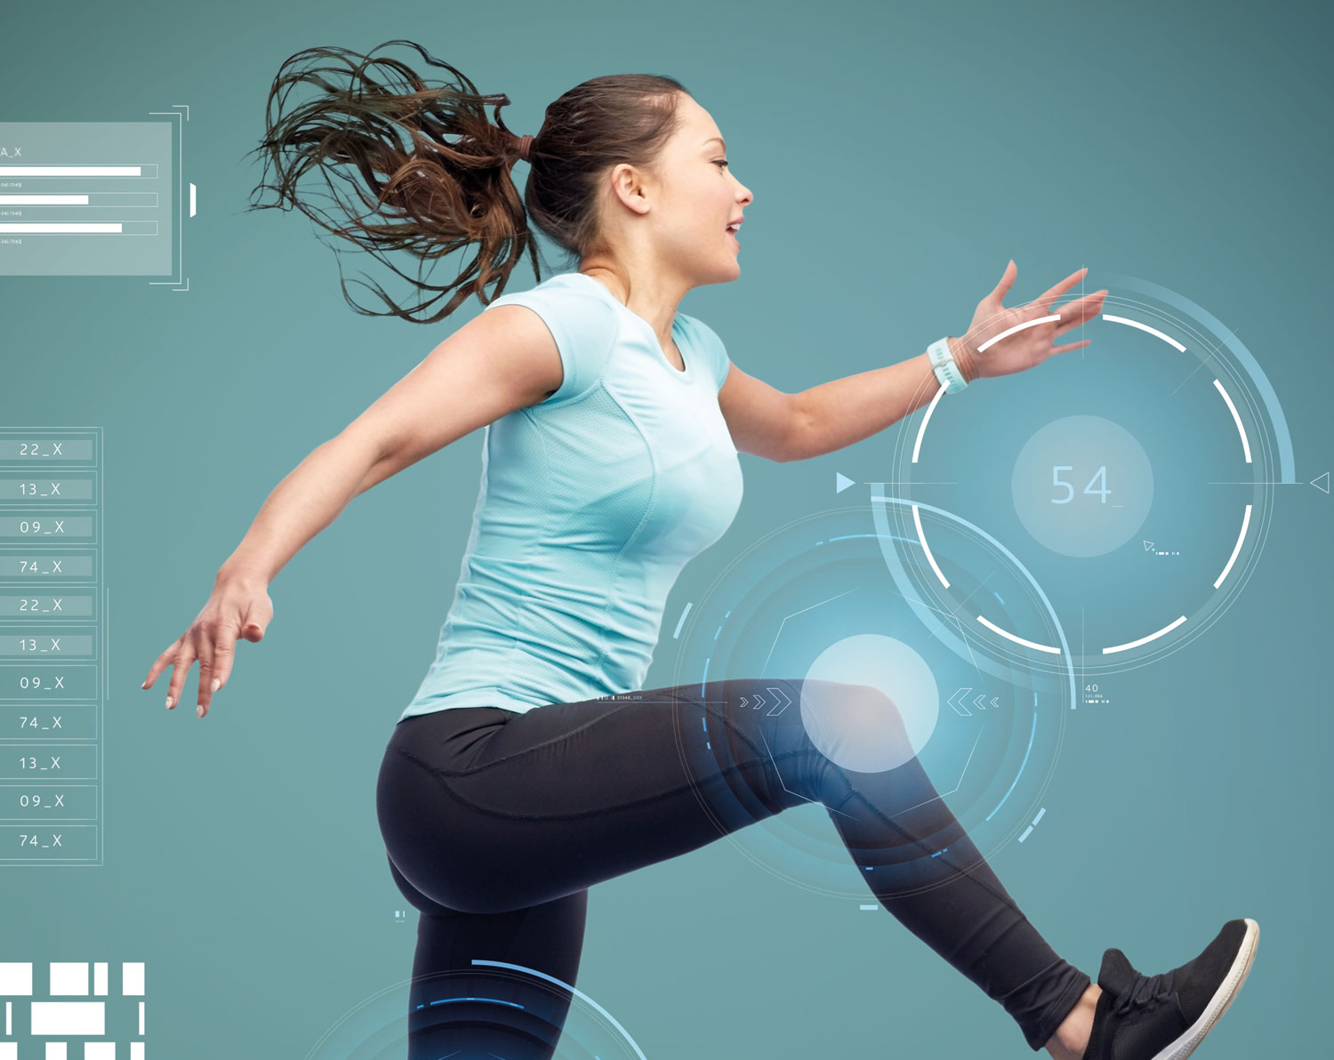
Future of AI in Health & Prevention
Personalized healthcare
Early disease detection
Predictive health analytics
Telemedicine and remote monitoring
Health and wellness wearables
Highly personalized healthcare by analyzing health data, genetic information, and lifestyle factors to provide tailored prevention and treatment
AI diagnostics (image and pattern recognition) enable early detection of diseases, allowing timely intervention and improved outcomes.
Big data and predictive analytics used to identify health trends and potential outbreaks, aiding in the proactive disease prevention
Allow patients to receive real-time medical guidance and continuous monitoring, cutting the accidents and complication risk
Integration with wearable devices, providing individuals with continuous health tracking and coaching

Slide 9
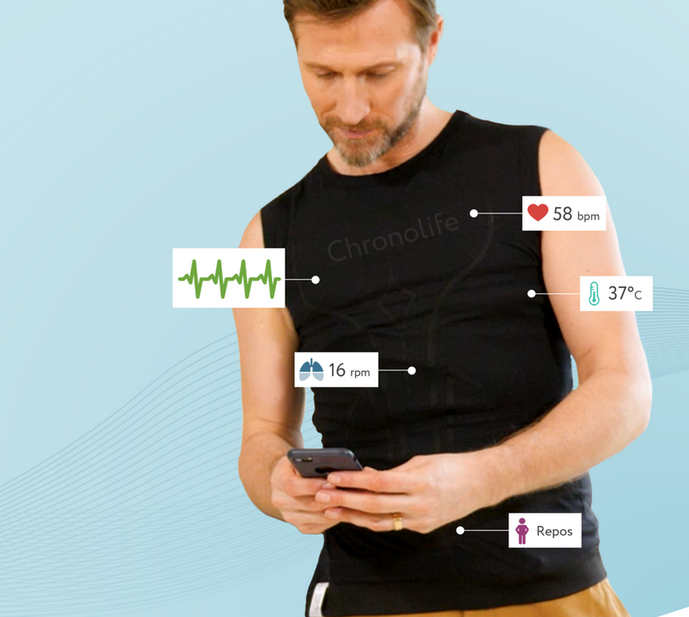
Technology Readiness
Use cases in your industry
Low
Med
High
Smart Textiles: Health monitoring via T-shirt
Market Readiness
Low
Med
High
Monitoring patients from the comfort of their home
AI affects the…
Process
Product
Communication
Sports applications
Use in high-risk occupations

Slide 10
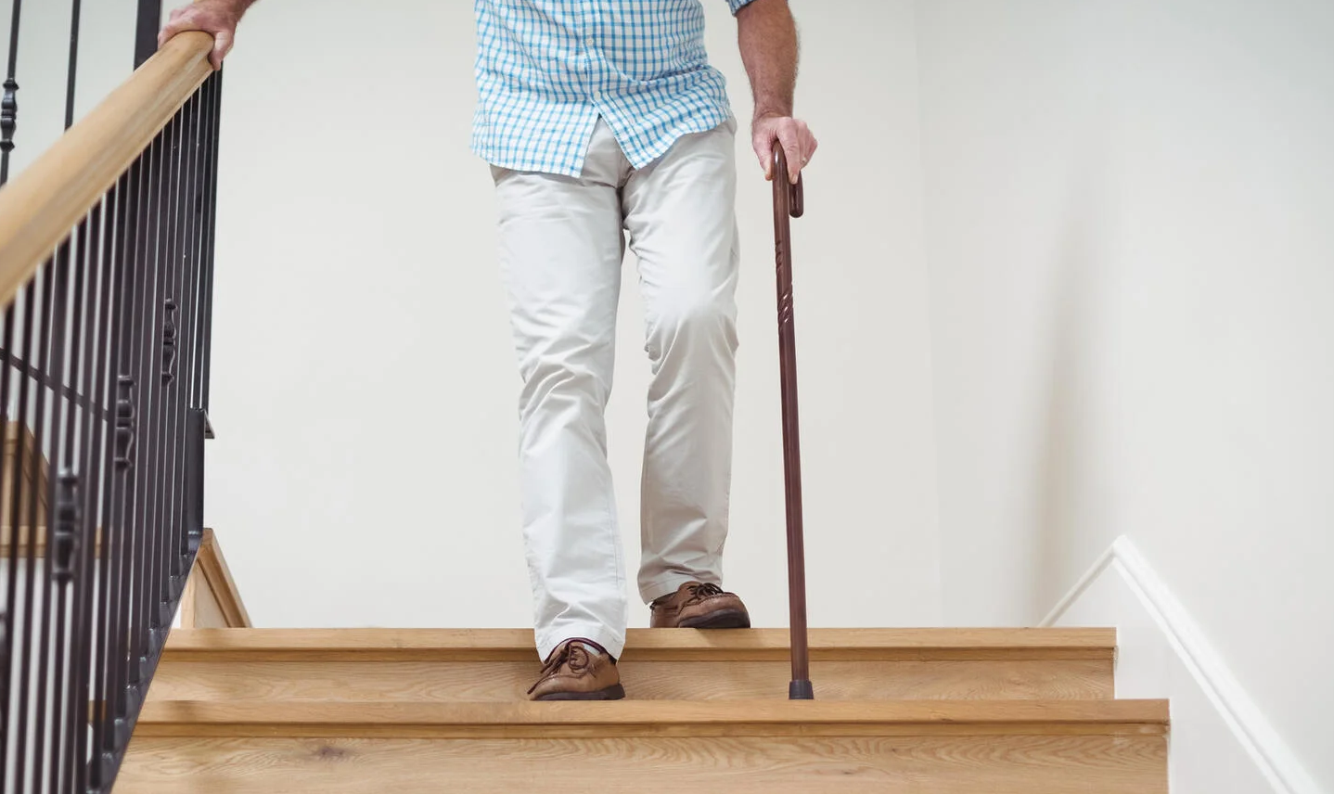
Technology Readiness
Use cases in your industry
Low
Med
High
Smart monitoring of the elderly‘s health via sound waves
Market Readiness
Low
Med
High
AI affects the…
Detection of current status (e.g., eating, walking, in bathroom)
Process
Product
Communication
Automatic alerting of medical staff

Slide 11
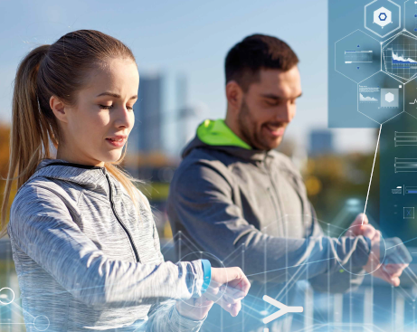
Technology Readiness
Use cases in your industry
Low
Med
High
Prediction of depression treatment outcomes with wearables
Market Readiness
Low
Med
High
AI affects the…
Process
Product
Communication
Assess chances for future successful psychological treatments

Slide 12
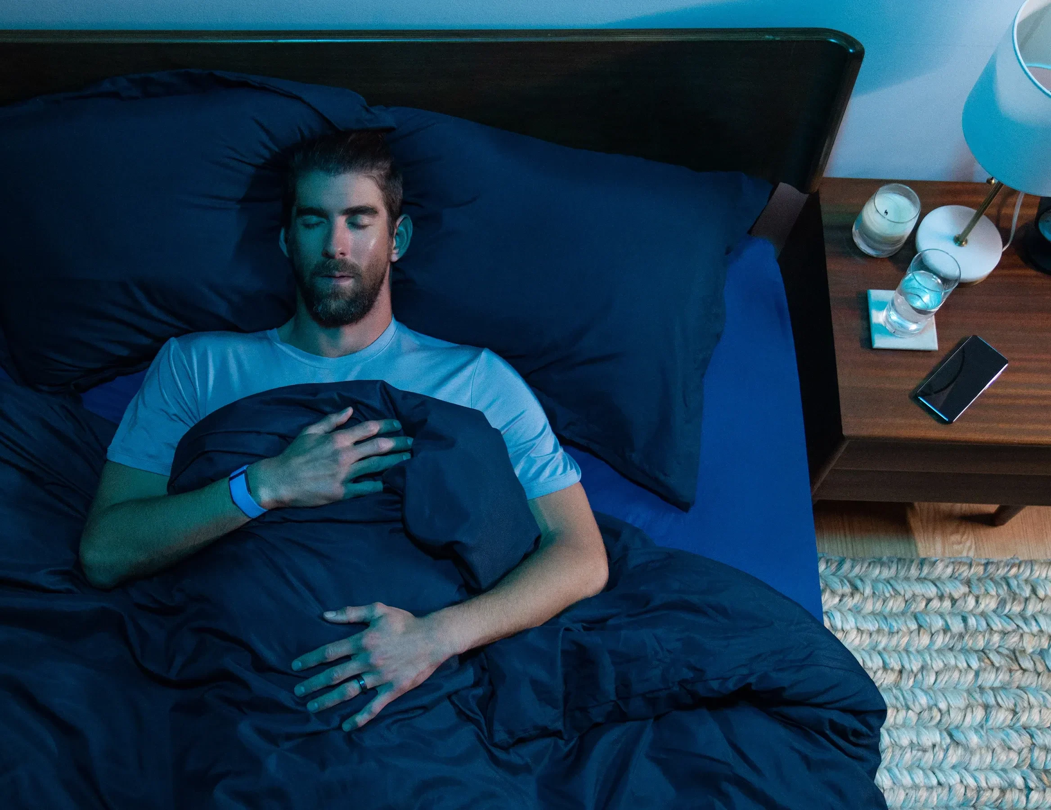
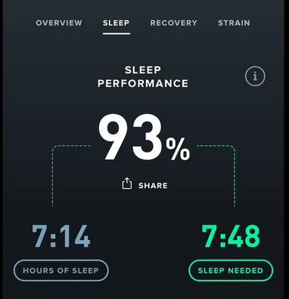
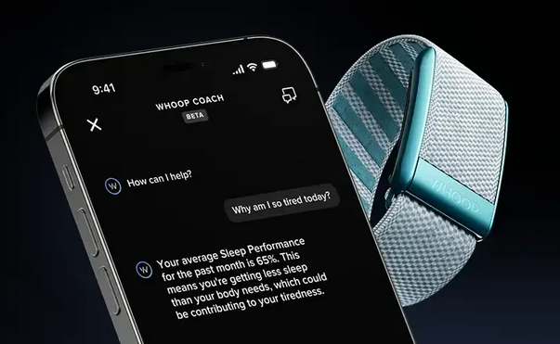
Technology Readiness
Use cases in your industry
Low
Med
High
AI sleep tracking technology
Market Readiness
Low
Med
High
AI affects the…
Process
Product
Communication

Slide 13


To select the best AI tools, businesses should:
Verify long-term viability
Calculate potential ROI
Assess data privacy & integration
Consider maintenance of the system
Evaluate expertise
Research options
Ensure scalability and integration
Test during a trial period
Analyze costs
Check user feedback
Define specific needs

Slide 14

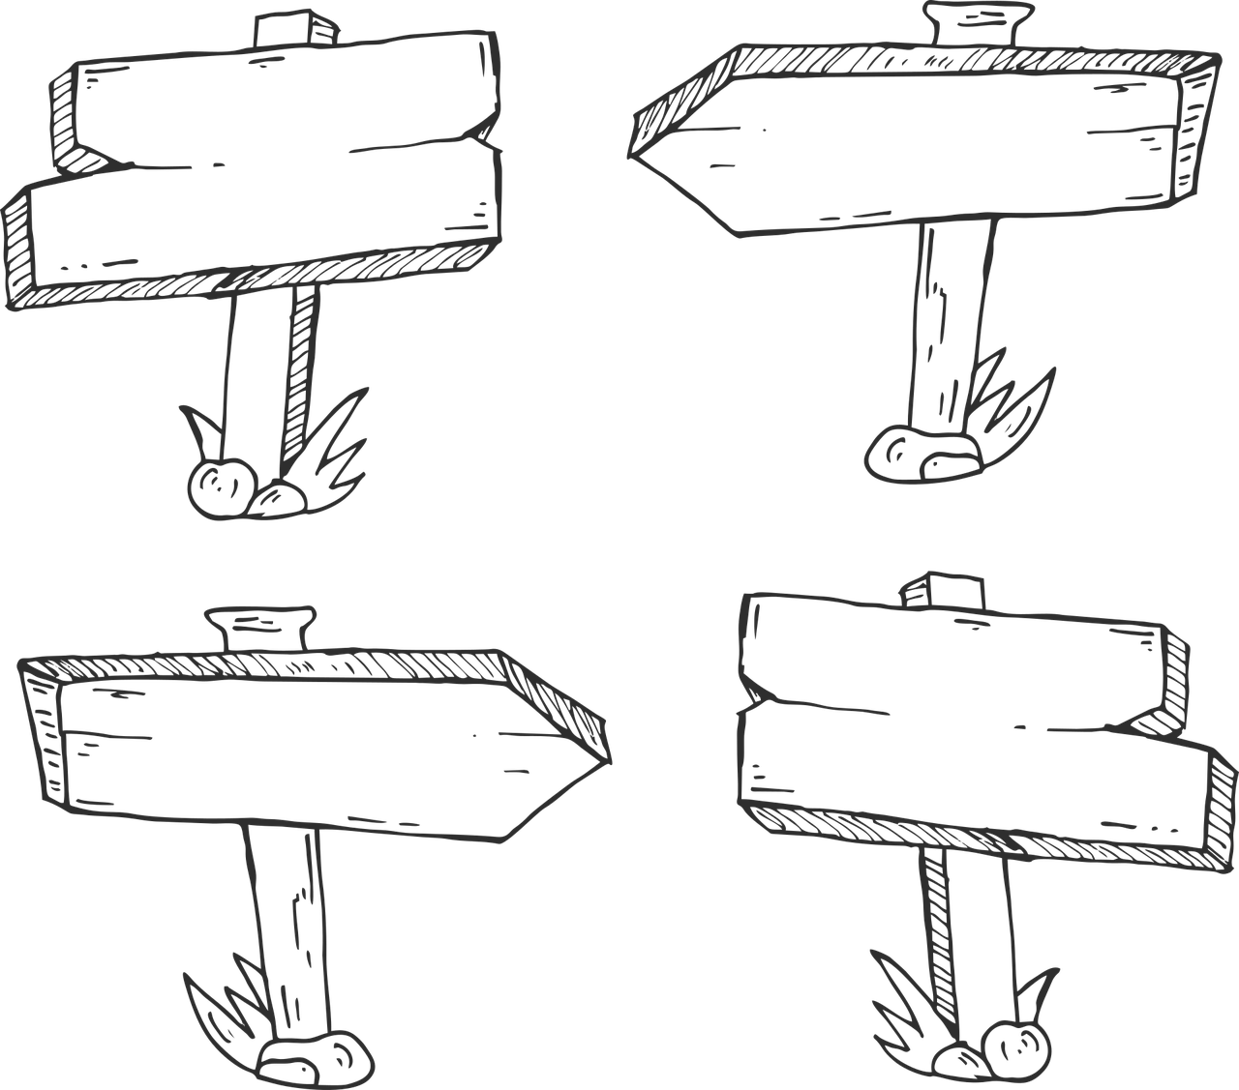

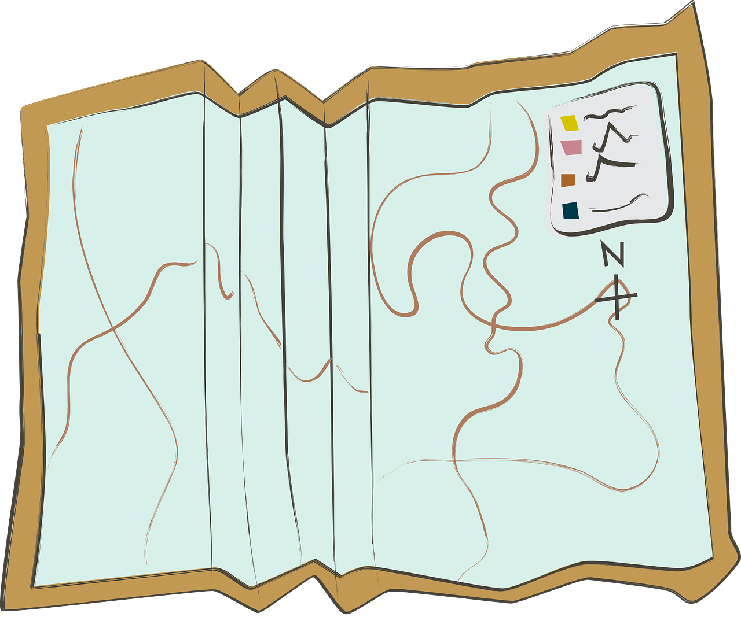
Where to go from here?
If you would like to:
Realize your innovation potentials
Grasp empowering AI tools for your business processes
Make the most out of your company‘s data
Better recognize your customers‘ needs
Search out potential new business models in times of the digital transformation
Let‘s unpack it together

Slide 15
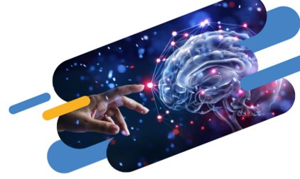
Stay tuned!
Next trend break on AI in tourism mobility
August 1st | 11.00
More information: www.crowd-in-motion.eu

Slide 16

(P.S. - Some of this presentation‘s contents were made using generative AI!)
Thank you!
Michael Thelen, BSc MA
(Salzburg Research)
+43/662/2288-308
michael.thelen@salzburgresearch.at

