Slide 1






Welcome to the Trend Break
Revolutionizing Trails:
Trends on AI and digitalization
in the Biking Industry

Slide 2



About today
11.00 | Welcome and event objectives Eva Hollauf, Coordinator EDIH Crowd in Motion, Salzburg Research
11.05 | Trend brief: AI’s advancement in the biking industry Michael Thelen, Salzburg Research
11.15 | Target groups in biking based on market research insights Stephan Grapentin, Mountainbike Tourismus Forum
11.20 | Digital product and service development of cargo bikes Philip James Douglas, SwissFleet Services
11.35 | Innovative data gathering and analysis using a smart e-bike Hannah Wies, Salzburg Research
11.50 | Q&A and joint discussion
12.15 | End of trend break – Enjoy your lunch!
Notes:
Organisation (mute, questions chat --> Q&A at the end, recording, we will contact you afterwards with a summary and information about EDIH and services), visit Crowd in Motion Website

Slide 3

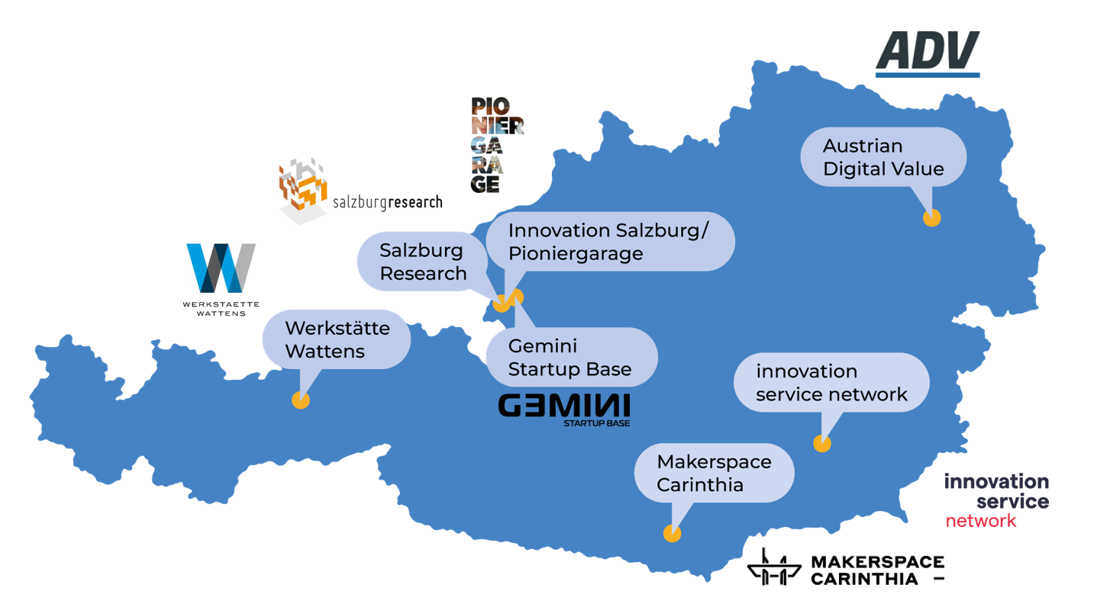
Innovation support for the digital transformation in the tourism, sport and leisure industry
www.crowd-in-motion.eu

Slide 4

AI in the Biking Industry:
Trends and Insights
Michael Thelen, MA
Salzburg Research

Slide 5
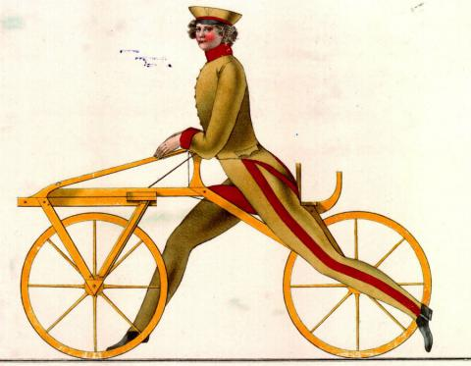

What has changed?

Slide 6
Where does Machine Learning have Impact?
State of Enterprise Machine Learning 2023, Zuhlke

Slide 7

Why Deep Learning?
AI
Machine Learning
Deep Learning
AI
Deep learning
Improved efficiency
Cost reduction
Enhanced decision-making
Personalized customer experiences
Analyze large volumes of data quickly
Performance
Older learning algorithms
Amount of data
Mueller & Massaron, 2018

Slide 8
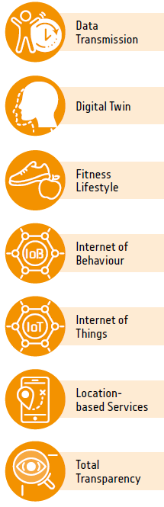

What is trending?
Transparency &
Privacy
WATCH
Critical
Enablers
PREPARE
Responsible AI
ACT
Neuromorphic
computing
Human-Centered AI
Edge Computer Vision
Model
Compression
Smart Space
Edge AI
Now to 3 Years
Self-Supervised
Learning
Synthetic Data
Spatial Computing
1 to 3 Years
3 to 6 Years
Generative AI
Smart
World
Productivity
Revolution
6 to 8 Years
Range until mainstream adoption

Slide 9



Future of AI in Biking
AI for Route Optimization
Smart Bikes and IoT
AI for Safety and Security
AI for Performance and Training
Environmental Impact
AI can analyze traffic patterns and suggest optimal routes for bikers, as well as provide real-time updates on road conditions and hazards.
The integration of IoT technology with bikes can help track and monitor performance, as well as provide real-time data for route optimization and safety.
AI-powered safety features can help prevent accidents and theft, as well as provide emergency services with real-time location data.
AI can analyze performance data to provide personalized training plans and improve overall biking abilities.
AI-powered bikes can help reduce carbon emissions and promote sustainable transportation.

Slide 10

Technology Readiness
Use cases in your industry
Low
Med
High
E-bikes with AI technology
Market Readiness
Low
Med
High
A company has launched a new bike model that combines AI technology to enhance the riding experience with predictive analytics and adjusts shifting behaviour and range to match rider performance, with a complementing app for system analysis and optimisation.
AI affects the…
Process
Product
Communication

Slide 11

Technology Readiness
Use cases in your industry
Low
Med
High
AI-Assisted Performance Diagnostics
Market Readiness
Low
Med
High
- Anarobic threshold
- Maximum oxygen uptake, lactate production rate and fat metabolism
- Create an individual metabolic profile
- Measure carbohydrate consumption and optimal pacing strategies
AI affects the…
Process
Product
Communication

Slide 12
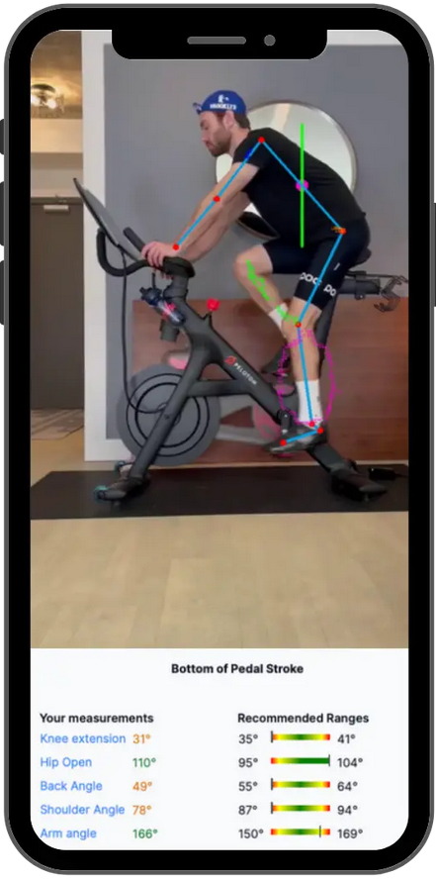
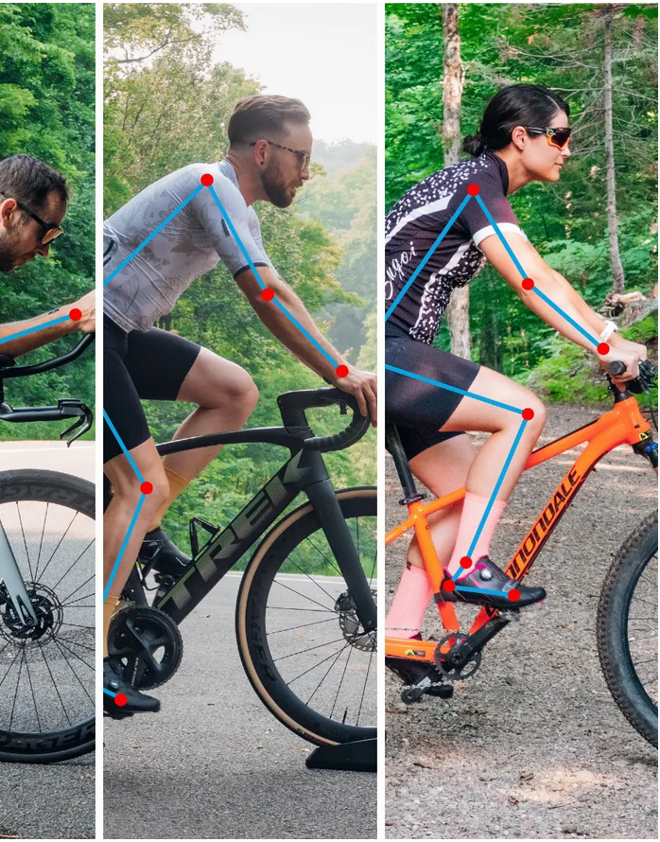
Technology Readiness
Use cases in your industry
Low
Med
High
Market Readiness
Low
Med
High
AI affects the…
AI-Assisted Bicycle
Fit Testing
Process
Product
Communication

Slide 13

Technology Readiness
Use cases in your industry
Low
Med
High
Bike with integrated ChatGPT feature
Market Readiness
Low
Med
High
„Here is a 10km cycling route for one day of sightseeing in Los Angeles.“
AI affects the…
Process
Product
Communication
Bicyclists can ask the chatbot a question, which is answered using its own language model.

Slide 14


To select the best AI tools, businesses should:
Verify long-term viability
Calculate potential ROI
Assess data privacy & integration
Consider maintenance of the system
Evaluate expertise
Research options
Ensure scalability and integration
Test during a trial period
Analyze costs
Check user feedback
Define specific needs

Slide 15

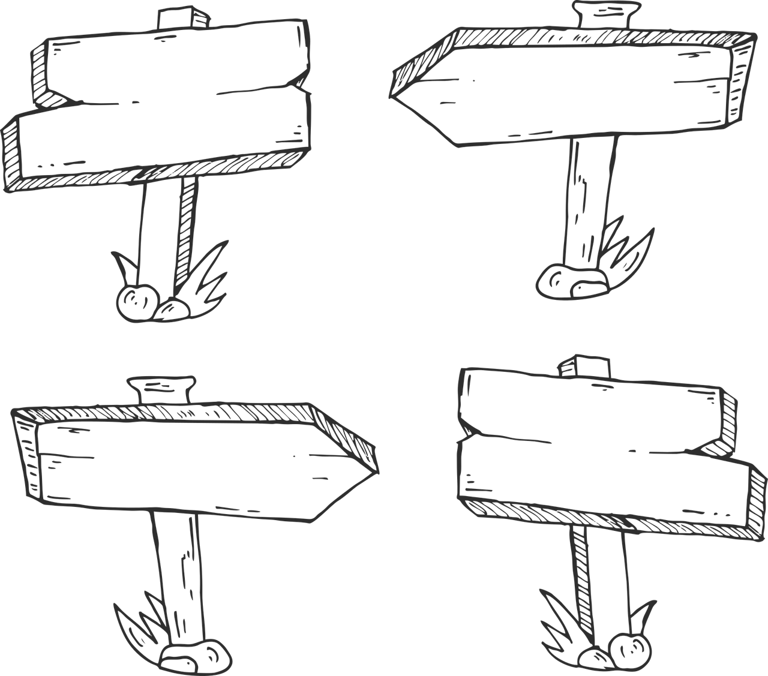

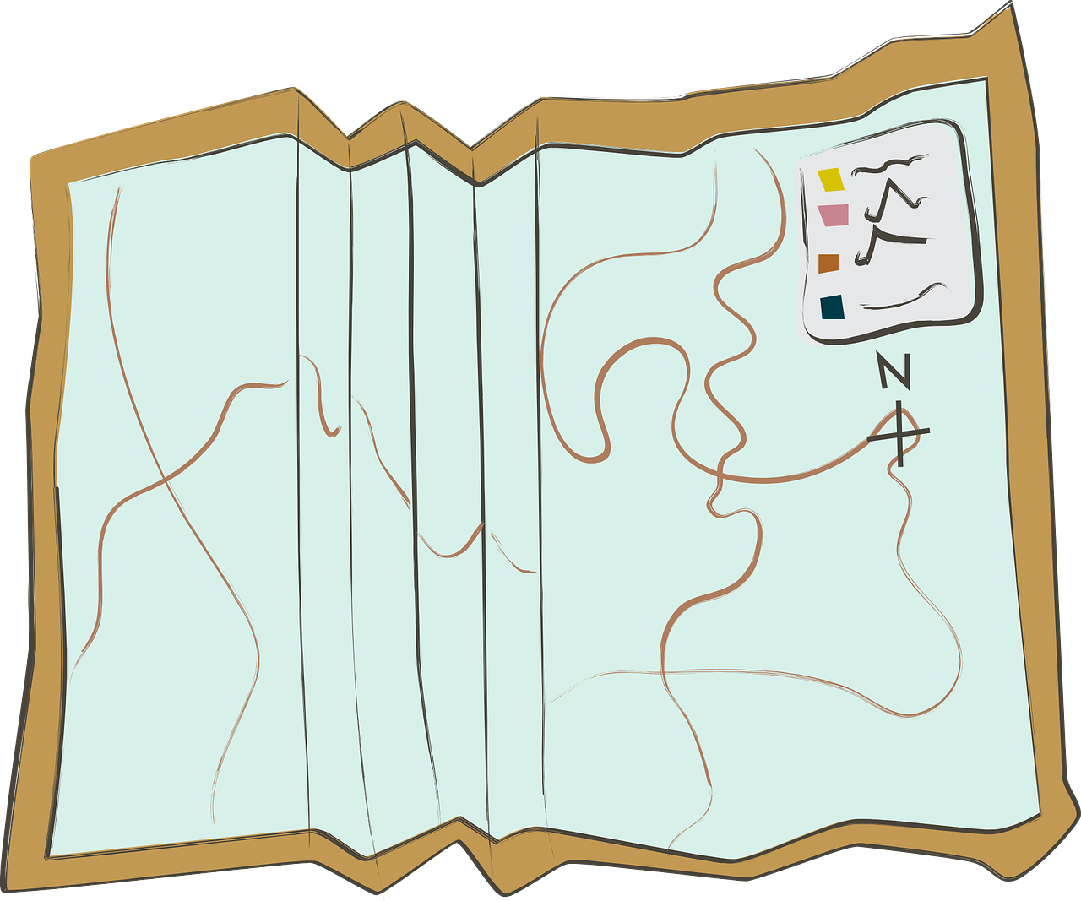
Where to go from here? www.crowd-in-motion.eu
If you would like to:
Realize your innovation potentials
Grasp empowering AI/digitalization tools for your business processes
Make the most out of your company‘s data
Better recognize your customers‘ needs
Search out potential new business models in times of the digital transformation
Let‘s unpack it together

Slide 16
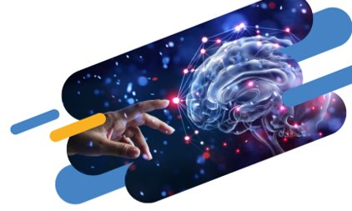
You want to catch up?
Next trend break on AI in tourism mobility:
July 25th | 11.00
Meet EDIH AUSTRIA EDIHs at the Innovation Conference "salz21"
March 6th & 7th, Salzburg
www.crowd-in-motion.eu/events
More information: www.crowd-in-motion.eu

Slide 17


Meet the experts:
Join Euro'Meet:
3 days dedicated to innovation in outdoor sports, with the goal of inspiring sustainable and active citizens.
https://euromeetlecco.com
Visit the MountainBike Congress in Germany
Find out the latest news about MTB in workshops, panels and presentations
https://www.kongress.bike
www.mtf.bike

Slide 18

(P.S. - Some of this presentation‘s contents were made using generative AI!)
Thank you!
Michael Thelen, MA
(Salzburg Research)
+43/662/2288-308
michael.thelen@salzburgresearch.at
https://www.crowd-in-motion.eu/

Slide 19

Tips for integrating AI into your business
1
UNDERSTAND YOUR GOALS
How can AI deal with your pain factors?
2
ENSURE DATA QUALITY
The highest data quality delivers the greatest insight
3
DISCUSS WITH YOUR TEAM
Instruct/discuss its potential benefits with your team
4
ASSIST HUMAN SKILLS
See how AI can complement, not replace, worker tasks
5
START SMALL WITH PILOTS
Initially, explore AI solutions in a managed environment
6
ITERATE AND LEARN
Continuously improve its implementation
7
CHOOSE THE RIGHT AI
Choose AI tools align with your goals
8
CHANGE MANAGEMENT STRATEGIES
Based on new AI capabilities

